Slide 1
NE 591: Advanced Reactor Materials
Fall 2021
Dr. Benjamin Beeler

Slide 2
Last Time
Started F/M steels

Slide 3
advanced cladding

Slide 4
Irradiation Embrittlement
Ferritic steels have these large monocarbides which aid in creep resistance
The lath boundaries are decorated with Cr rich M23C6 precipitates which increase the thermal stability
Embrittlement is caused by 1) segregation of elements to lath boundaries which make the grain boundaries decohesive, and 2) evolution of carbides and intermetallic phases
For removable components such as clad, which are subjected to high temperature and pressure with a residence time of a few years, creep embrittlement is the issue which decides their design and performance
For permanent support structures increase in hardening and loss in fracture toughness on irradiation are major issues

Slide 5
Irradiation Embrittlement
The increase in the ductile to brittle transition temperature, DBTT, is known to be related to irradiation hardening, which is generally observed to saturate with fluence
Evidence for a possible maximum in DBTT was observed for the 12Cr steel irradiated in the range of 35–100 dpa in the FFTF
High fluence and/or high temperature are required before a maximum is observed
Thus, these properties are a balance between the point defect production and irradiation-induced precipitation
The precipitation during irradiation hardens the steel and irradiation accelerated recovery and aging soften the steel
The high temperature recovery produces an observable saturation in hardening above ~720K

Slide 6
DBTT
BCC materials can undergo significant increase in the DBTT at low T for even 1 dpa
The minimum operating temperature to avoid embrittlement F/M steels is ~500 K
Extensive evaluation of the embrittlement behavior of the ferritic steels for different chemistry has been performed
Compositions around 9Cr show the least change in the DBTT
Chemical variation affects on DBTT changes has been thoroughly studied
Addition of phosphorous, copper, vanadium, aluminum, and silicon increase the DBTT

Slide 7
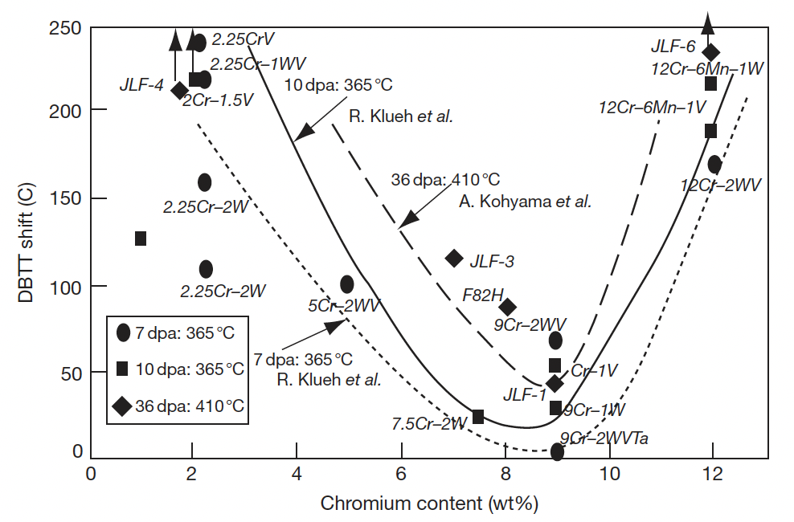
DBTT
The 12Cr steels, HT9, show a larger shift in DBTT as compared to modified 9Cr–1Mo steel
The balance is always between nearly nil swelling resistant 12Cr steels and 9Cr steel which is less prone to embrittlement than 12Cr steels

Slide 8
Features affecting Embrittlement
There are a number of microstructural features that can impact the embrittlement of F/M steels
Prior austenite grain size (PAGS)
The size of martensitic lath and packet (which is sensitive to austenitization temperature)
Tempering/annealing, which can increase carbide precipitate size
The generation of helium through (n,alpha) reaction
For low thickness components, the triaxial stress necessary for the embrittlement does not develop, which reduces the intensity of this otherwise serious problem of embrittlement in ferritic steels

Slide 9
Ferritic/Martensitic Steels Summary

Slide 10
ODS Steels

Slide 11
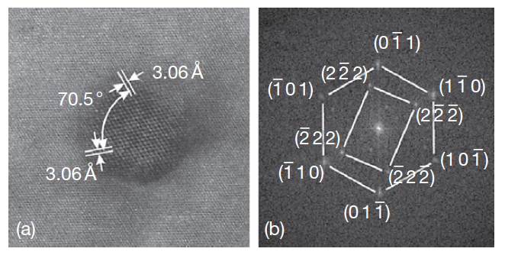
Oxide Dispersion Strengthened
Thermally stable oxide particles dispersed in the ferritic matrix improve the radiation resistance and creep resistance at high temperature
ODS steels have a strong potential for high burnup (long- life) and high temperature applications typical for SFR fuels
Typically, Y2O3 particles or Y2Ti2O7 particles
Y2O3 particle with surrounding matrix

Slide 12
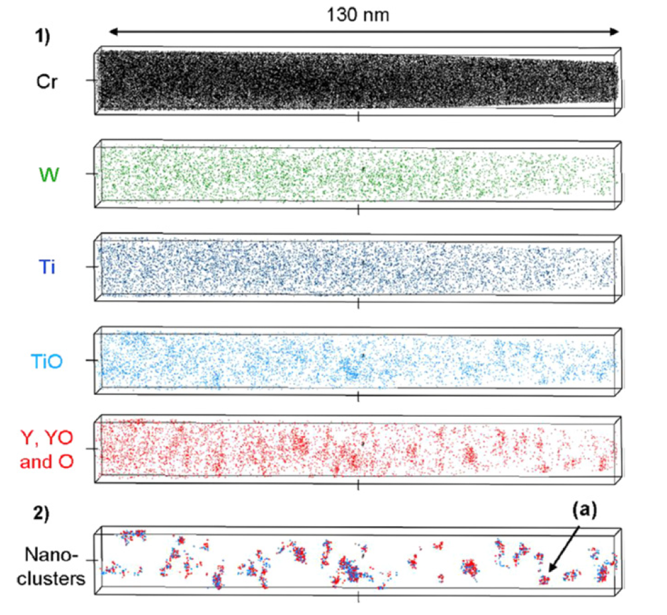
Y2O3 Decomposition
The fine distribution of Y2O3 particles is attained by the dissociation of stable Y2O3 particles which are forced to decomposed into the ferritic steel matrix during the mechanical alloying process
The lattice structure change of Y2O3 in the ODS steel during MA consists of three stages: (1) destruction of the lattice structure, (2) formation of a blurry lattice structure, (3) appearance of amorphous areas

Slide 13
9Cr-ODS
For nuclear applications, the choice of 9 wt% Cr with a tempered martensitic matrix is preferable to suppress the ductility loss by irradiation hardening and improve the microstructure stability and creep strength at high temperature
The high-temperature strength of 9Cr-ODS is drastically improved by nano-scale oxide particles dispersion in the matrix
The standard chemical composition of 9Cr-ODS being developed by the JAEA for SFR application is 9Cr–0.13C–0.2Ti–2W– 0.35Y2O3 (wt%)
The addition of titanium produces the nanoscale dispersion of oxide particles
Tungsten of 2 wt% is also added in order to improve high-temperature strength by means of solid solution hardening

Slide 14
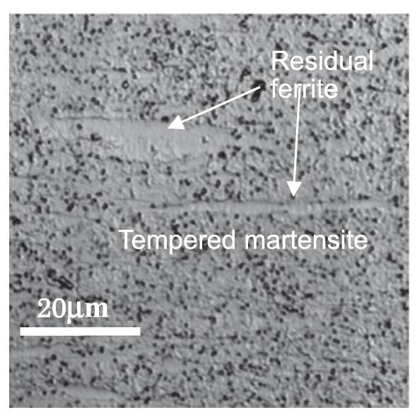
9Cr-ODS microstructure
The microstructure of 9Cr-ODS steel cladding is basically tempered martensite, but includes some residual ferrite phases
Only the full martensite phase can be expected in 9Cr-ferritic steel without yttria under the same conditions
The high temperature strength is greatly improved with the ferrite, and thus control of ferrite is key in ODS fabrication

Slide 15
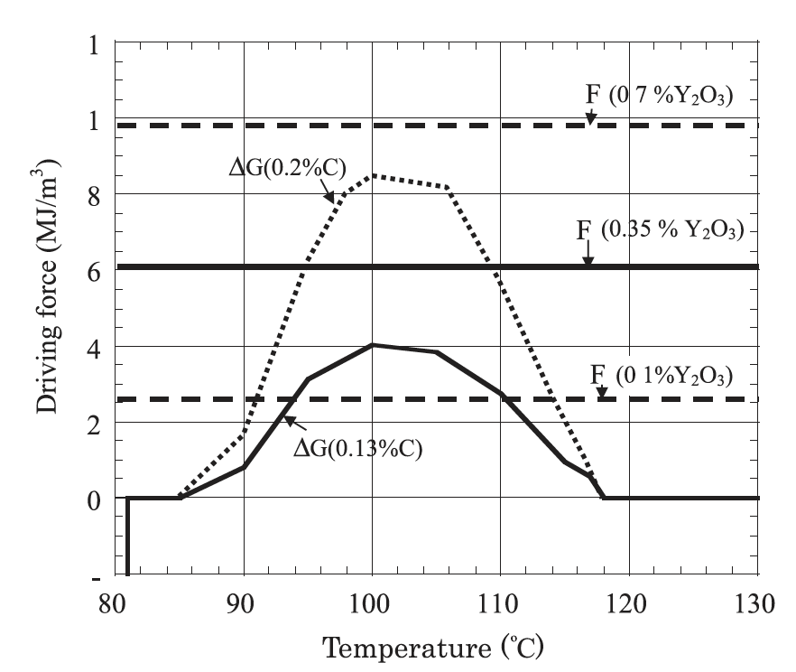
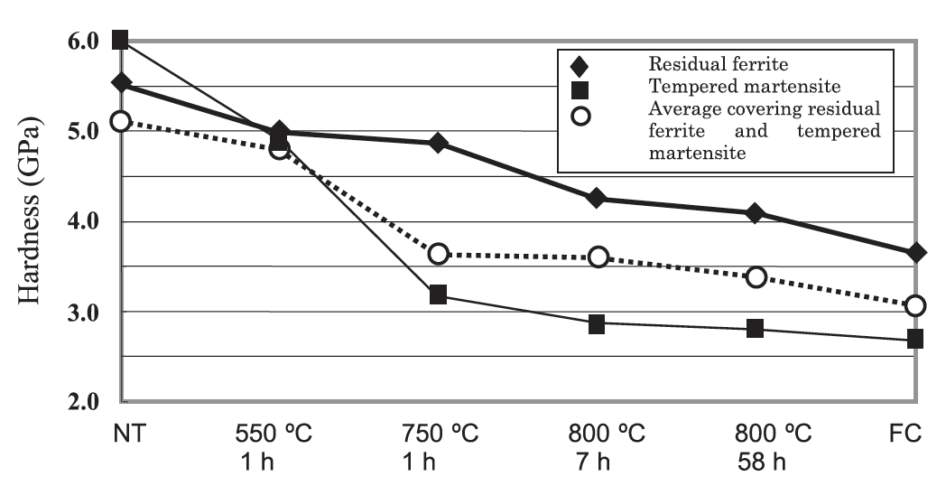
Residual Ferrite
Annealing results in the formation and precipitation of Y–Ti complex oxide particles at elevated temperatures of 700C or higher
Since the reverse transformation of alpha (ferrite) to gamma (austenite) takes place at a temperature over 850C, alpha ferrite is attributed to the presence of the Y-Ti-O particles
These particles block the motion of the alpha-gamma interface, there by partly suppressing the reverse transformation from alpha to gamma-phase

